Slide 1
Assembly Language for x86 Processors 6th Edition
Kip Irvine
Chapter 1: Basic Concepts

Slide 2
Chapter Overview
Welcome to Assembly Language
X86 Processors
MASM
Virtual Machine Concept
Machines running other machines
Data Representation
Bits and bytes
Boolean Operations
AND, OR, NOT

Slide 3
Welcome to Assembly Language
Some Good Questions to Ask
Assembly Language Applications

Slide 4
Questions to Ask
Why am I learning Assembly Language?
Oldest language; closest to HW
What background should I have?
What is an assembler?
Translates assembly language into machine language
What hardware/software do I need?
What types of programs will I create?
Console programs for 16-bit and 32-bit address mode
What do I get with this book?
What will I learn?
Data rep; debugging; programming; HW manipulation

Slide 5
Welcome to Assembly Language (cont)
How does assembly language (AL) relate to machine language?
Machine language is numeric; AL is symbolic (almost)
How do C++ and Java relate to AL?
One C++ or Java statement translates into many AL statements
Is AL portable?
Usually NO
Why learn AL?
Embedded programs, hardware interaction, OS, device drivers, game consoles

Slide 6
Assembly Language Applications
Some representative types of applications:
Business application for single platform
Hardware device driver
Business application for multiple platforms
Embedded systems & computer games
(see next panel)

Slide 7
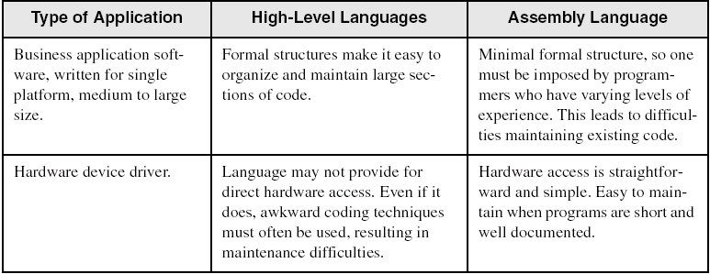
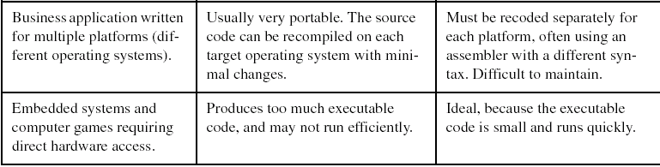
Comparing ASM to High-Level Languages

Slide 8
What's Next
Welcome to Assembly Language
Virtual Machine Concept
Data Representation
Boolean Operations

Slide 9
Virtual Machine Concept
Virtual Machines
Specific Machine Levels

Slide 10
Virtual Machines
Tanenbaum: Virtual machine concept
Programming Language analogy:
Each computer has a native machine language (language L0) that runs directly on its hardware
A more human-friendly language is usually constructed above machine language, called Language L1
Programs written in L1 can run two different ways:
Interpretation – L0 program interprets and executes L1 instructions one by one
Translation – L1 program is completely translated into an L0 program, which then runs on the computer hardware

Slide 11
Translating Languages
English: Display the sum of A times B plus C.
C++: cout << (A * B + C);
Assembly Language:
mov eax,A
mul B
add eax,C
call WriteInt
Intel Machine Language:
A1 00000000
F7 25 00000004
03 05 00000008
E8 00500000

Slide 12
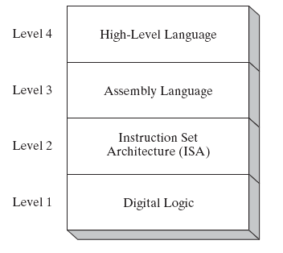
Specific Machine Levels
(descriptions of individual levels follow . . . )

Slide 13
High-Level Language
Level 4
Application-oriented languages
C++, Java, Pascal, Visual Basic . . .
Programs compile into assembly language (Level 3)

Slide 14
Assembly Language
Level 3
Instruction mnemonics that have a one-to-one correspondence to machine language
Programs are translated into Instruction Set Architecture Level - machine language (Level 2)

Slide 15
Instruction Set Architecture (ISA)
Level 2
Also known as conventional machine language
Executed by Level 1 (Digital Logic)

Slide 16
Digital Logic
Level 1
CPU, constructed from digital logic gates
System bus
Memory
Implemented using bipolar transistors
next: Data Representation

Slide 17
What's Next
Welcome to Assembly Language
Virtual Machine Concept
Data Representation
Boolean Operations

Slide 18
Data Representation
Binary Numbers
Translating between binary and decimal
Binary Addition
Integer Storage Sizes
Hexadecimal Integers
Translating between decimal and hexadecimal
Hexadecimal subtraction
Signed Integers
Binary subtraction
Character Storage

Slide 19
Binary Numbers
Digits are 1 and 0
1 = true
0 = false
MSB – most significant bit
LSB – least significant bit
Bit numbering:

Slide 20
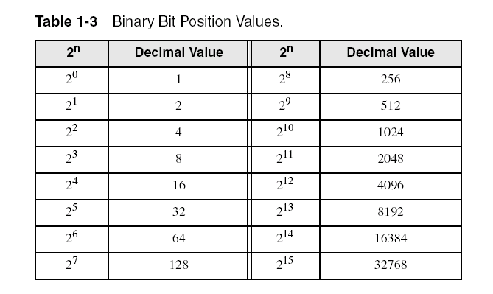
Binary Numbers
Each digit (bit) is either 1 or 0
Each bit represents a power of 2:
Every binary number is a sum of powers of 2

Slide 21
Translating Binary to Decimal
Weighted positional notation shows how to calculate the decimal value of each binary bit:
dec = (D_{n-1} × 2^{n-1}) + (D_{n-2} × 2^{n-2}) + ... + (D₁ × 2¹) + (D₀ × 2⁰)
D = binary digit
binary 00001001 = decimal 9:
(1 × 2³) + (1 × 2⁰) = 9

Slide 22
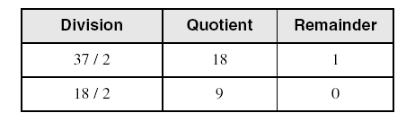
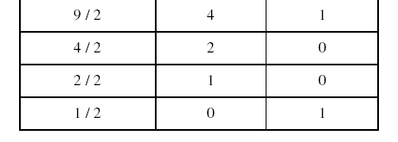
Translating Unsigned Decimal to Binary
Repeatedly divide the decimal integer by 2. Each remainder is a binary digit in the translated value:
37 = 100101

Slide 23
Binary Addition
Starting with the LSB, add each pair of digits, include the carry if present.

Slide 24
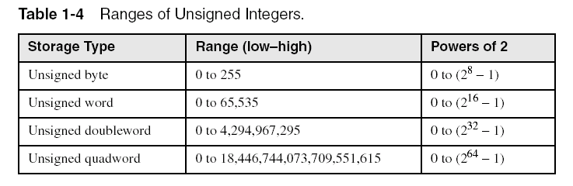
Integer Storage Sizes
Standard sizes:
What is the largest unsigned integer that may be stored in 20 bits?

Slide 25
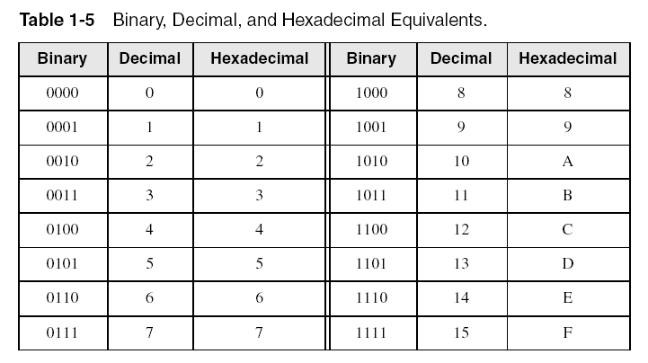
Hexadecimal Integers
Binary values are represented in hexadecimal.

Slide 26

Translating Binary to Hexadecimal
Each hexadecimal digit corresponds to 4 binary bits.
Example: Translate the binary integer 000101101010011110010100 to hexadecimal:

Slide 27
Converting Hexadecimal to Decimal
Multiply each digit by its corresponding power of 16:
dec = (D₃ × 16³) + (D₂ × 16²) + (D₁ × 16¹) + (D₀ × 16⁰)
Hex 1234 equals (1 × 16³) + (2 × 16²) + (3 × 16¹) + (4 × 16⁰), or decimal 4,660.
Hex 3BA4 equals (3 × 16³) + (11 * 16²) + (10 × 16¹) + (4 × 16⁰), or decimal 15,268.

Slide 28
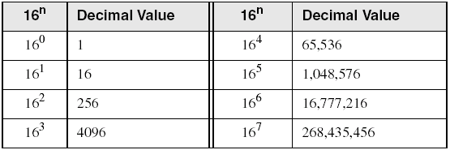
Powers of 16
Used when calculating hexadecimal values up to 8 digits long:

Slide 29
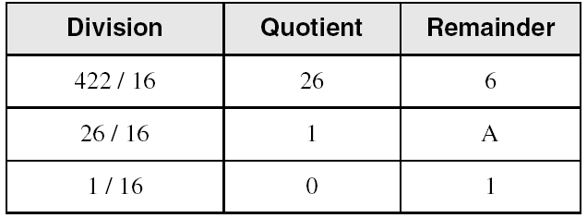
Converting Decimal to Hexadecimal
decimal 422 = 1A6 hexadecimal

Slide 30
Hexadecimal Addition
Divide the sum of two digits by the number base (16). The quotient becomes the carry value, and the remainder is the sum digit.
1
1
36 28 28 6A
42 45 58 4B
78 6D 80 B5
21 / 16 = 1, rem 5
Important skill: Programmers frequently add and subtract the addresses of variables and instructions.

Slide 31
Hexadecimal Subtraction
When a borrow is required from the digit to the left, add 16 (decimal) to the current digit's value:
16 + 5 = 21
−1
C6 75
A2 47
24 2E
Practice: The address of var1 is 00400020. The address of the next variable after var1 is 0040006A. How many bytes are used by var1?

Slide 32
Signed Integers
The highest bit indicates the sign. 1 = negative, 0 = positive
If the highest digit of a hexadecimal integer is > 7, the value is negative. Examples: 8A, C5, A2, 9D

Slide 33
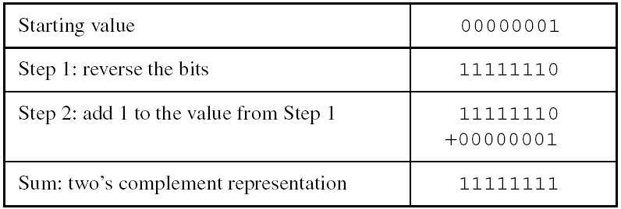
Forming the Two's Complement
Negative numbers are stored in two's complement notation
Represents the additive Inverse
Note that 00000001 + 11111111 = 00000000

Slide 34
Binary Subtraction
When subtracting A – B, convert B to its two's complement
Add A to (–B)
0 0 0 0 1 1 0 0 0 0 0 0 1 1 0 0
– 0 0 0 0 0 0 1 1 1 1 1 1 1 1 0 1
0 0 0 0 1 0 0 1
Practice: Subtract 0101 from 1001.

Slide 35
Learn How To Do the Following:
Form the two's complement of a hexadecimal integer
Convert signed binary to decimal
Convert signed decimal to binary
Convert signed decimal to hexadecimal
Convert signed hexadecimal to decimal

Slide 36
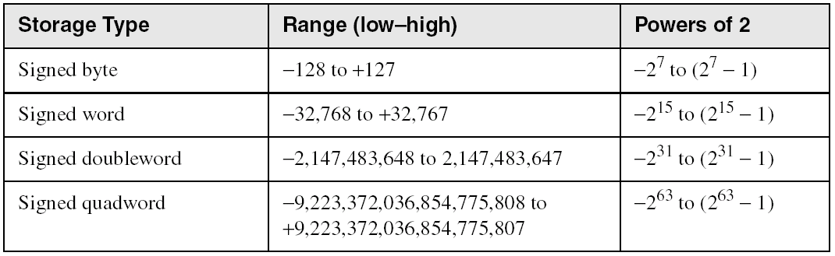
Ranges of Signed Integers
The highest bit is reserved for the sign. This limits the range:
Practice: What is the largest positive value that may be stored in 20 bits?

Slide 37
Character Storage
Character sets
Standard ASCII (0 – 127)
Extended ASCII (0 – 255)
ANSI (0 – 255)
Unicode (0 – 65,535)
Null-terminated String
Array of characters followed by a null byte
Using the ASCII table
back inside cover of book

Slide 38
Numeric Data Representation
pure binary
can be calculated directly
ASCII binary
string of digits: "01010101"
ASCII decimal
string of digits: "65"
ASCII hexadecimal
string of digits: "9C"
next: Boolean Operations

Slide 39
What's Next
Welcome to Assembly Language
Virtual Machine Concept
Data Representation
Boolean Operations

Slide 40
Boolean Operations
NOT
AND
OR
Operator Precedence
Truth Tables

Slide 41
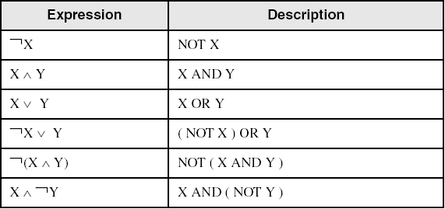
Boolean Algebra
Based on symbolic logic, designed by George Boole
Boolean expressions created from:
NOT, AND, OR

Slide 42
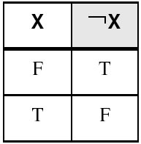
NOT
Inverts (reverses) a boolean value
Truth table for Boolean NOT operator:
Digital gate diagram for NOT:

Slide 43
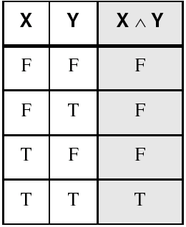
AND
Truth table for Boolean AND operator:
Digital gate diagram for AND:

Slide 44
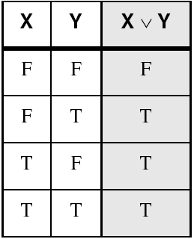
OR
Truth table for Boolean OR operator:
Digital gate diagram for OR:

Slide 45
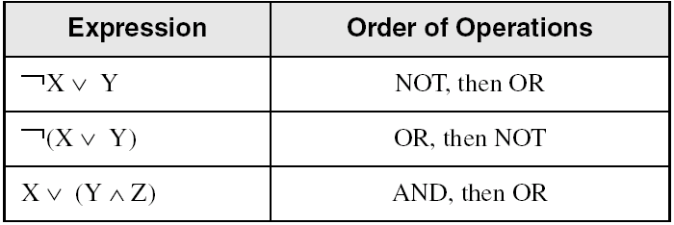
Operator Precedence
Examples showing the order of operations:

Slide 46
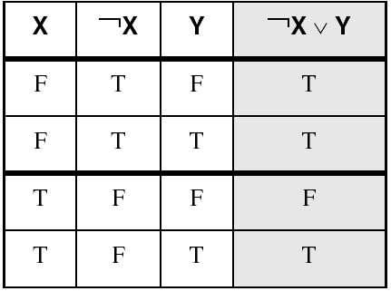
Truth Tables (1 of 3)
A Boolean function has one or more Boolean inputs, and returns a single Boolean output.
A truth table shows all the inputs and outputs of a Boolean function
Example: ¬X ∨ Y

Slide 47
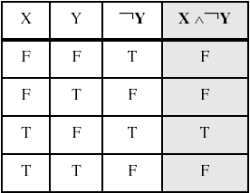
Truth Tables (2 of 3)
Example: X ∧ ¬Y

Slide 48
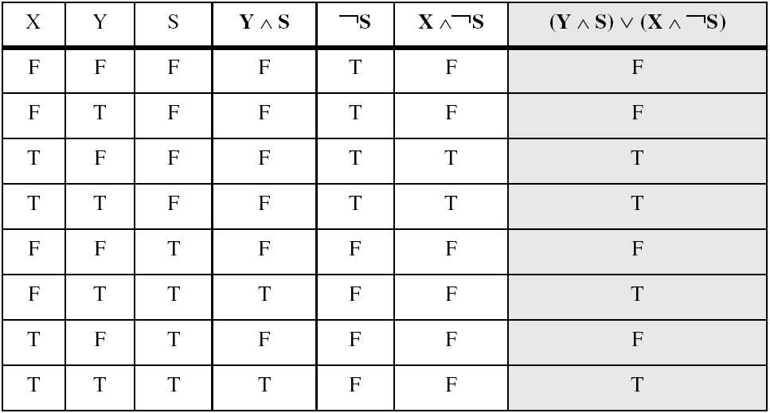
Truth Tables (3 of 3)
Example: (Y ∧ S) ∨ (X ∧ ¬S)
Two-input multiplexer

Slide 49
Summary
Assembly language helps you learn how software is constructed at the lowest levels
Assembly language has a one-to-one relationship with machine language
Each layer in a computer's architecture is an abstraction of a machine
layers can be hardware or software
Boolean expressions are essential to the design of computer hardware and software

Slide 50
Assembly Language for x86 Processors 6th Edition
Kip Irvine
Chapter 2: x86 Processor Architecture

Slide 51
Chapter Overview
General Concepts
IA-32 Processor Architecture
IA-32 Memory Management
Components of an IA-32 Microcomputer
Input-Output System

Slide 52
General Concepts
Basic microcomputer design
Instruction execution cycle
Reading from memory
How programs run

Slide 53
Basic Microcomputer Design
clock synchronizes CPU operations
control unit (CU) coordinates sequence of execution steps
ALU performs arithmetic and bitwise processing

Slide 54
Clock
synchronizes all CPU and BUS operations
machine (clock) cycle measures time of a single operation
clock is used to trigger events

Slide 55
What's Next
General Concepts
IA-32 Processor Architecture
IA-32 Memory Management
Components of an IA-32 Microcomputer
Input-Output System

Slide 56
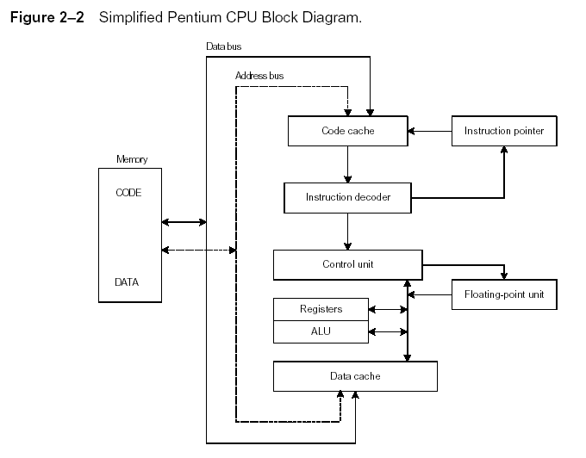
Instruction Execution Cycle
Instruction Execution Cycle
Fetch
Decode
Fetch operands
Execute
Store output

Slide 57
Instruction Execution Cycle
Fetch – CU gets next instruction from the instruction queue and increments instruction pointer (IP)
Decode – CU determines the instruction’s function and the instruction’s input operands are sent to the ALU; signals are sent to ALU to tell it what to do
Fetch Operands – if operand is located in memory, CU issues a “read” to retrieve the data and put it in internal registers
Execute – ALU performs instruction and sends output to registers or memory
Store output operand – if operand is in memory, CU issues a “write” operation

Slide 58
Reading from Memory (clock – GHz)
Multiple machine cycles are required when reading from memory, because it responds much more slowly than the CPU. The steps are:
address placed on address bus
Read Line (RD) set low
CPU waits one cycle for memory to respond
Read Line (RD) goes to 1, indicating that the data is on the data bus

Slide 59
Cache Memory
High-speed expensive static RAM both inside and outside the CPU.
Level-1 cache: inside the CPU
Level-2 cache: outside the CPU
Cache hit: when data to be read is already in cache memory
Cache miss: when data to be read is not in cache memory.

Slide 60
How a Program Runs

Slide 61
Load and Execute Process
OS searches for program’s filename in disk directory, or in predetermined list (paths)
OS retrieves basic info about program from disk directory (file size, physical location)
OS determines free space in memory and loads the program; keeps data in descriptor file, and may adjust addresses within the program
OS begins execution of program. Now the program is called a process. OS assigns a process ID number.
OS tracks execution of program and responds to system resource requests from the program.

Slide 62
Multitasking
OS can run multiple programs at the same time.
Multiple threads of execution within the same program.
Scheduler utility assigns a given amount of CPU time to each running program.
Rapid switching of tasks
gives illusion that all programs are running at once
the processor must support task switching.

Slide 63
IA-32 Processor Architecture
Modes of operation
Basic execution environment
Floating-point unit
Intel Microprocessor history

Slide 64
Modes of Operation
Protected mode
native mode (Windows, Linux); programs cannot address outside area they are assigned
Real-address mode
native MS-DOS; dangerous; direct access to HW
System management mode
power management, system security, diagnostics
Virtual-8086 mode
hybrid of Protected
each program has its own 8086 computer

Slide 65
Basic Execution Environment
Addressable memory
General-purpose registers
Index and base registers
Specialized register uses
Status flags
Floating-point, MMX, XMM registers

Slide 66
Addressable Memory
Protected mode
Linear up to about 4 GB
32-bit address
P6 processors can go to 64 GB
Real-address and Virtual-8086 modes
1 MB space
20-bit address

Slide 67
General-Purpose Registers
Named storage locations inside the CPU, optimized for speed.

Slide 68
The alphabet
A = Accumulator P = Pointer
B = Base X = Register
C = Counter or Code
D = Data
E = Extended
F = Flag
I = Index or Instruction
H = High
L = Low
S = Segment or Stack

Slide 69
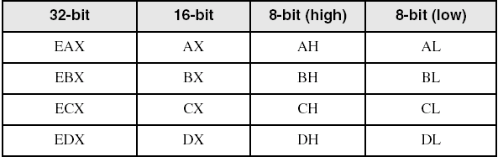
Accessing Parts of Registers
Use 8-bit name, 16-bit name, or 32-bit name
Applies to EAX, EBX, ECX, and EDX

Slide 70
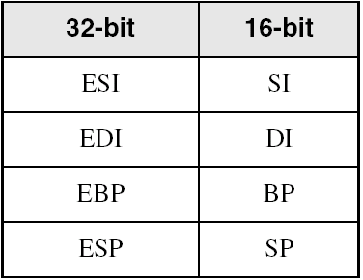
Index and Base Registers
Some registers have only a 16-bit name for their lower half:

Slide 71
Some Specialized Register Uses (1 of 2)
General-Purpose
EAX – accumulator
ECX – loop counter
ESP – stack pointer
ESI, EDI – index registers
EBP – extended frame pointer (stack)
Segment
CS – code segment
DS – data segment
SS – stack segment
ES, FS, GS - additional segments

Slide 72
Some Specialized Register Uses (2 of 2)
EIP – instruction pointer
EFLAGS
status and control flags
each flag is a single binary bit

Slide 73
Status Flags
Carry -CF
unsigned arithmetic out of range
Overflow - OF
signed arithmetic out of range
Sign - SF
result is negative
Zero - ZF
result is zero
Auxiliary Carry - AF
carry from bit 3 to bit 4
Parity - PF
sum of 1 bits is an even number
Trap – TF
Causes processor to execute in single steps
Interrupt – IF
Disable external interrupts
Direction – DF
Used in string operations

Slide 74
Flag Register Bits
 | 14 | 13 | 12 | 11 | 10 | 09 | 08 | 07 | 06 | 05 | 04 | 03 | 02 | 01 | 00
 |  |  |  | O | D | I | T | S | Z |  | A |  | P |  | C

Slide 75
Floating-Point, MMX, XMM Registers
MM = Multimedia
Eight 80-bit floating-point data registers
ST(0), ST(1), . . . , ST(7)
arranged in a stack
used for all floating-point arithmetic
Eight 64-bit MMX registers
Eight 128-bit XMM registers for single-instruction multiple-data (SIMD) operations

Slide 76
Intel Microprocessor History
Intel 8086, 80286
IA-32 processor family
P6 processor family
CISC and RISC

Slide 77
Early Intel Microprocessors
Intel 8080
64K addressable RAM
8-bit registers
CP/M operating system
S-100 BUS architecture
8-inch floppy disks!
Intel 8086/8088
IBM-PC Used 8088
1 MB addressable RAM
16-bit registers
16-bit data bus (8-bit for 8088)
separate floating-point unit (8087)

Slide 78
The IBM-AT
Intel 80286
16 MB addressable RAM
Protected memory
several times faster than 8086
introduced IDE bus architecture
IDE = Integrated Drive Electronics
80287 floating point unit

Slide 79
Intel IA-32 Family
Intel386
4 GB addressable RAM, 32-bit registers, paging (virtual memory)
Intel486
instruction pipelining
Pentium
superscalar, 32-bit address bus, 64-bit internal data path

Slide 80
64-bit Processors
Intel64
64-bit linear address space
Intel: Pentium Extreme, Xeon, Celeron D, Pendium D, Core 2, and Core i7
IA-32e Mode
Compatibility mode for legacy 16- and 32-bit applications
64-bit Mode uses 64-bit addresses and operands

Slide 81
Intel Technologies
HyperThreading technology
two tasks execute on a single processor at the same time
Dual Core processing
multiple processor cores in the same IC package
each processor has its own resources and communication path with the bus

Slide 82
Intel Processor Families
Currently Used:
Pentium & Celeron – dual core
Core 2 Duo - 2 processor cores
Core 2 Quad - 4 processor cores
Core i7 – 4 processor cores

Slide 83
CISC and RISC
CISC – complex instruction set
large instruction set
high-level operations
requires microcode interpreter
examples: Intel 80x86 family
RISC – reduced instruction set
simple, atomic instructions
small instruction set
directly executed by hardware
examples:
ARM (Advanced RISC Machines)
DEC Alpha (now Compaq)

Slide 84
What's Next
General Concepts
IA-32 Processor Architecture
IA-32 Memory Management
Components of an IA-32 Microcomputer
Input-Output System

Slide 85
IA-32 Memory Management
Real-address mode
Calculating linear addresses
Protected mode
Multi-segment model
Paging

Slide 86
Real-Address mode
1 MB RAM maximum addressable
Application programs can access any area of memory
Single tasking
Supported by MS-DOS operating system

Slide 87
Segmented Memory
Segmented memory addressing: absolute (linear) address is a combination of a 16-bit segment value added to a 16-bit offset
one segment
linear addresses

Slide 88
Calculating Linear Addresses
Given a segment address, multiply it by 16 (add a hexadecimal zero), and add it to the offset
Example: convert 08F1:0100 to a linear address
Adjusted Segment value: 0 8 F 1 0
Add the offset: 0 1 0 0
Linear address: 0 9 0 1 0

Slide 89
Your turn . . .
What linear address corresponds to the segment/offset address 028F:0030?
028F0 + 0030 = 02920
Always use hexadecimal notation for addresses.

Slide 90
Your turn . . .
What segment addresses correspond to the linear address 28F30h?
Many different segment-offset addresses can produce the linear address 28F30h. For example:
28F0:0030, 28F3:0000, 28B0:0430, . . .

Slide 91
Protected Mode (1 of 2)
4 GB addressable RAM
(00000000 to FFFFFFFFh)
Each program assigned a memory partition which is protected from other programs
Designed for multitasking
Supported by Linux & MS-Windows

Slide 92
Protected mode (2 of 2)
Segment descriptor tables
Program structure
code, data, and stack areas
CS, DS, SS segment descriptors
global descriptor table (GDT)
MASM Programs use the Microsoft flat memory model

Slide 93
Flat Segment Model
Single global descriptor table (GDT).
All segments mapped to entire 32-bit address space

Slide 94
Multi-Segment Model
Each program has a local descriptor table (LDT)
holds descriptor for each segment used by the program

Slide 95
Paging
Supported directly by the CPU
Divides each segment into 4096-byte blocks called pages
Sum of all programs can be larger than physical memory
Part of running program is in memory, part is on disk
Virtual memory manager (VMM) – OS utility that manages the loading and unloading of pages
Page fault – issued by CPU when a page must be loaded from disk

Slide 96
What's Next
General Concepts
IA-32 Processor Architecture
IA-32 Memory Management
Components of an IA-32 Microcomputer
Input-Output System

Slide 97
Components of an IA-32 Microcomputer
Motherboard
Video output
Memory
Input-output ports

Slide 98
Motherboard
CPU socket
External cache memory slots
Main memory slots
BIOS (basic input/output system) chips
Sound synthesizer chip (optional)
Video controller chip (optional)
IDE, parallel, serial, USB, video, keyboard, joystick, network, and mouse connectors
PCI bus connectors (expansion cards)

Slide 99
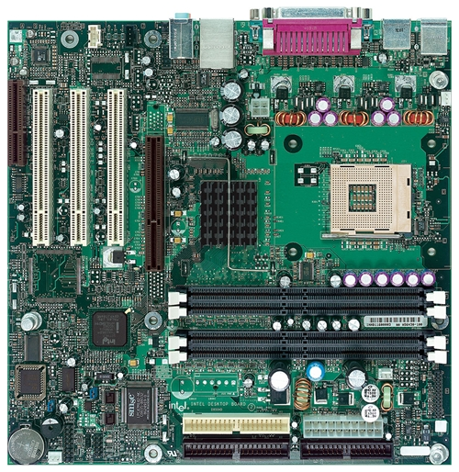
Intel D850MD Motherboard
mouse, keyboard, parallel, serial, and USB connectors
Video
Audio chip
PCI slots
memory controller hub
Pentium 4 socket
AGP slot
dynamic RAM
Firmware hub
I/O Controller
Speaker
Power connector
Battery
Diskette connector
Source: Intel® Desktop Board D850MD/D850MV Technical Product Specification
IDE drive connectors

Slide 100
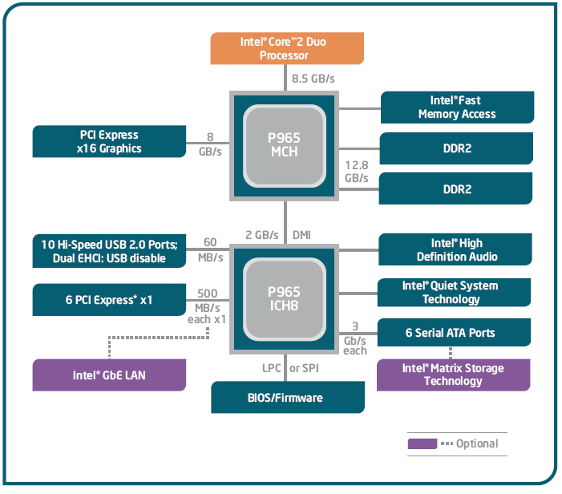
Intel 965 Express Chipset

Slide 101
Video Output
Video controller
on motherboard, or on expansion card
AGP (accelerated graphics port technology)*
Video memory (VRAM)
Video CRT Display
uses raster scanning
horizontal retrace
vertical retrace
Direct digital LCD monitors
no raster scanning required
* This link may change over time.

Slide 102
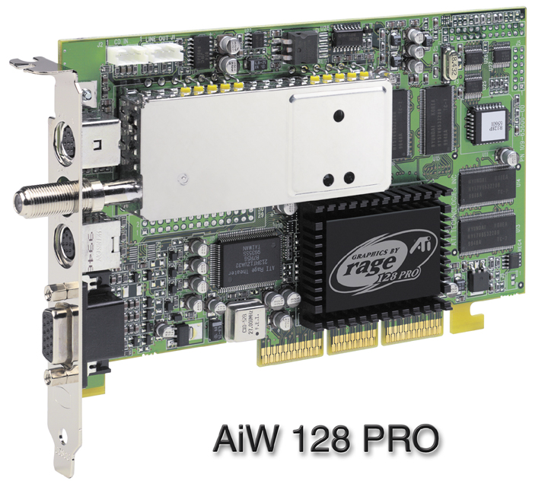
Sample Video Controller (ATI Corp.)
128-bit 3D graphics performance powered by RAGE™ 128 PRO
3D graphics performance
Intelligent TV-Tuner with Digital VCR
TV-ON-DEMAND™
Interactive Program Guide
Still image and MPEG-2 motion video capture
Video editing
Hardware DVD video playback
Video output to TV or VCR

Slide 103
Memory
ROM
read-only memory
EPROM
erasable programmable read-only memory
Dynamic RAM (DRAM)
inexpensive; must be refreshed constantly
Static RAM (SRAM)
expensive; used for cache memory; no refresh required
Video RAM (VRAM)
dual ported; optimized for constant video refresh
CMOS RAM
complimentary metal-oxide semiconductor
system setup information
See: Intel platform memory (Intel technology brief: link address may change)

Slide 104
Input-Output Ports
USB (universal serial bus)
intelligent high-speed connection to devices
up to 12 megabits/second
USB hub connects multiple devices
enumeration: computer queries devices
supports hot connections
Parallel
short cable, high speed
common for printers
bidirectional, parallel data transfer
Intel 8255 controller chip

Slide 105
Input-Output Ports (cont)
Serial
RS-232 serial port
one bit at a time
uses long cables and modems
16550 UART (universal asynchronous receiver transmitter)
programmable in assembly language

Slide 106
Device Interfaces
ATA host adapters
intelligent drive electronics (hard drive, CDROM)
SATA (Serial ATA)
inexpensive, fast, bidirectional
FireWire
high speed (800 MB/sec), many devices at once
Bluetooth
small amounts of data, short distances, low power usage
Wi-Fi (wireless Ethernet)
IEEE 802.11 standard, faster than Bluetooth

Slide 107
What's Next
General Concepts
IA-32 Processor Architecture
IA-32 Memory Management
Components of an IA-32 Microcomputer
Input-Output System

Slide 108
Levels of Input-Output
Level 3: High-level language function
examples: C++, Java
portable, convenient, not always the fastest
Level 2: Operating system
Application Programming Interface (API)
extended capabilities, lots of details to master
Level 1: BIOS
drivers that communicate directly with devices
OS security may prevent application-level code from working at this level

Slide 109
Displaying a String of Characters
When a HLL program displays a string of characters, the following steps take place:

Slide 110
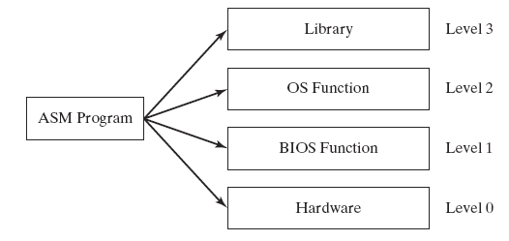
Programming levels
Assembly language programs can perform input-output at each of the following levels:

Slide 111
Summary
Central Processing Unit (CPU)
Arithmetic Logic Unit (ALU)
Instruction execution cycle
Multitasking
Floating Point Unit (FPU)
Complex Instruction Set
Real mode and Protected mode
Motherboard components
Memory types
Input/Output and access levels

